Slide 1
Data Structures And Algorithms
Aman Raj
B.Tech (CSE)
12101946

Slide 2
Table Of Content
My Course
I will discuss my summer training MOOC
Project
I will explain my project in detail
Learning Outcome
I will talk about the experience and skills I have gained from the course and project
Conclusion
I will give an overview of my training

Slide 3

Overview Of Course Data Structures And Algorithms
“Data Structures and Algorithms” is an online self paced course offered by “GeeksForGeeks” consisting of all the topics needed to learn about DSA and five mini projects using the concepts of DSA. This course teaches the essential skills for working with data structures and algorithms.

Slide 4
Project :- PhoneBook Directory using Python

Slide 5
Project Overview
I made a Phonebook Directory using python with the concept of Array , Function , Loops concept , Conditional Statement, Dictionary , Import statement. The Phonebook management have three main operations Searching, Sorting and Deleting. These three operations can be performed efficiently with Linked List.

Slide 6
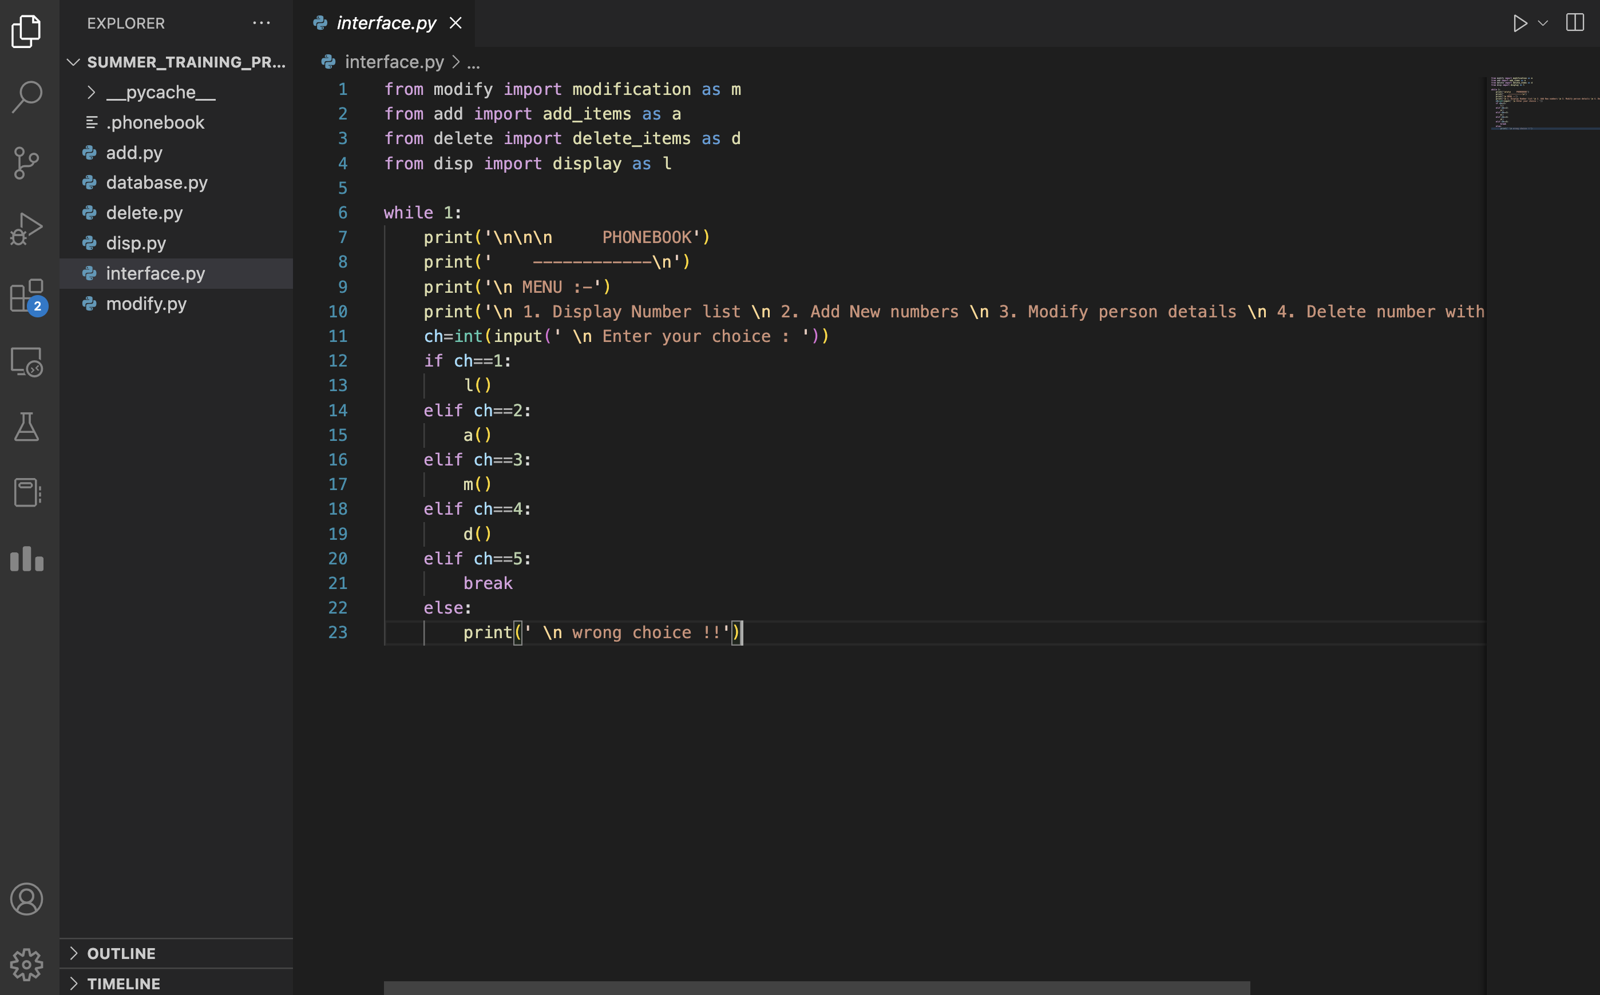
Project Screenshots

Slide 7
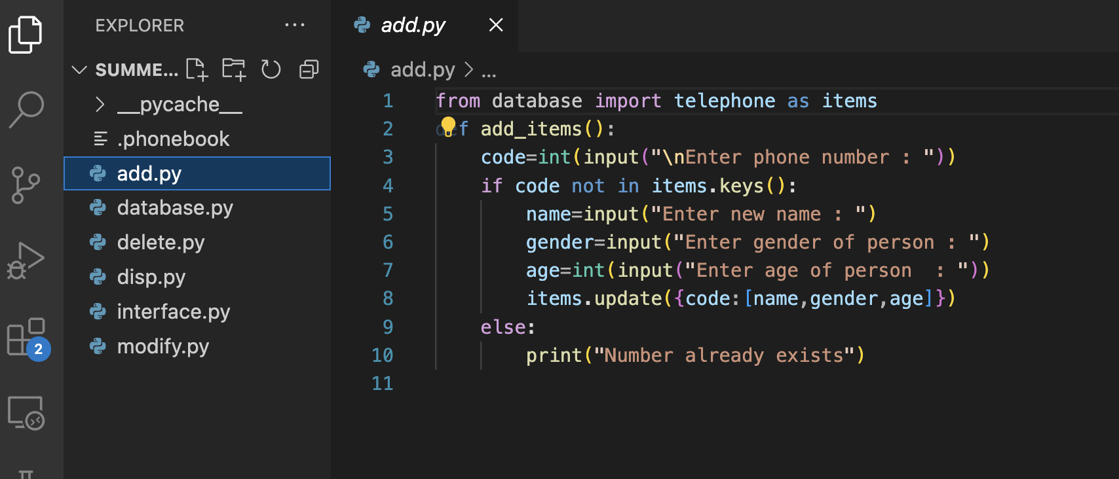
Project Screenshots

Slide 8
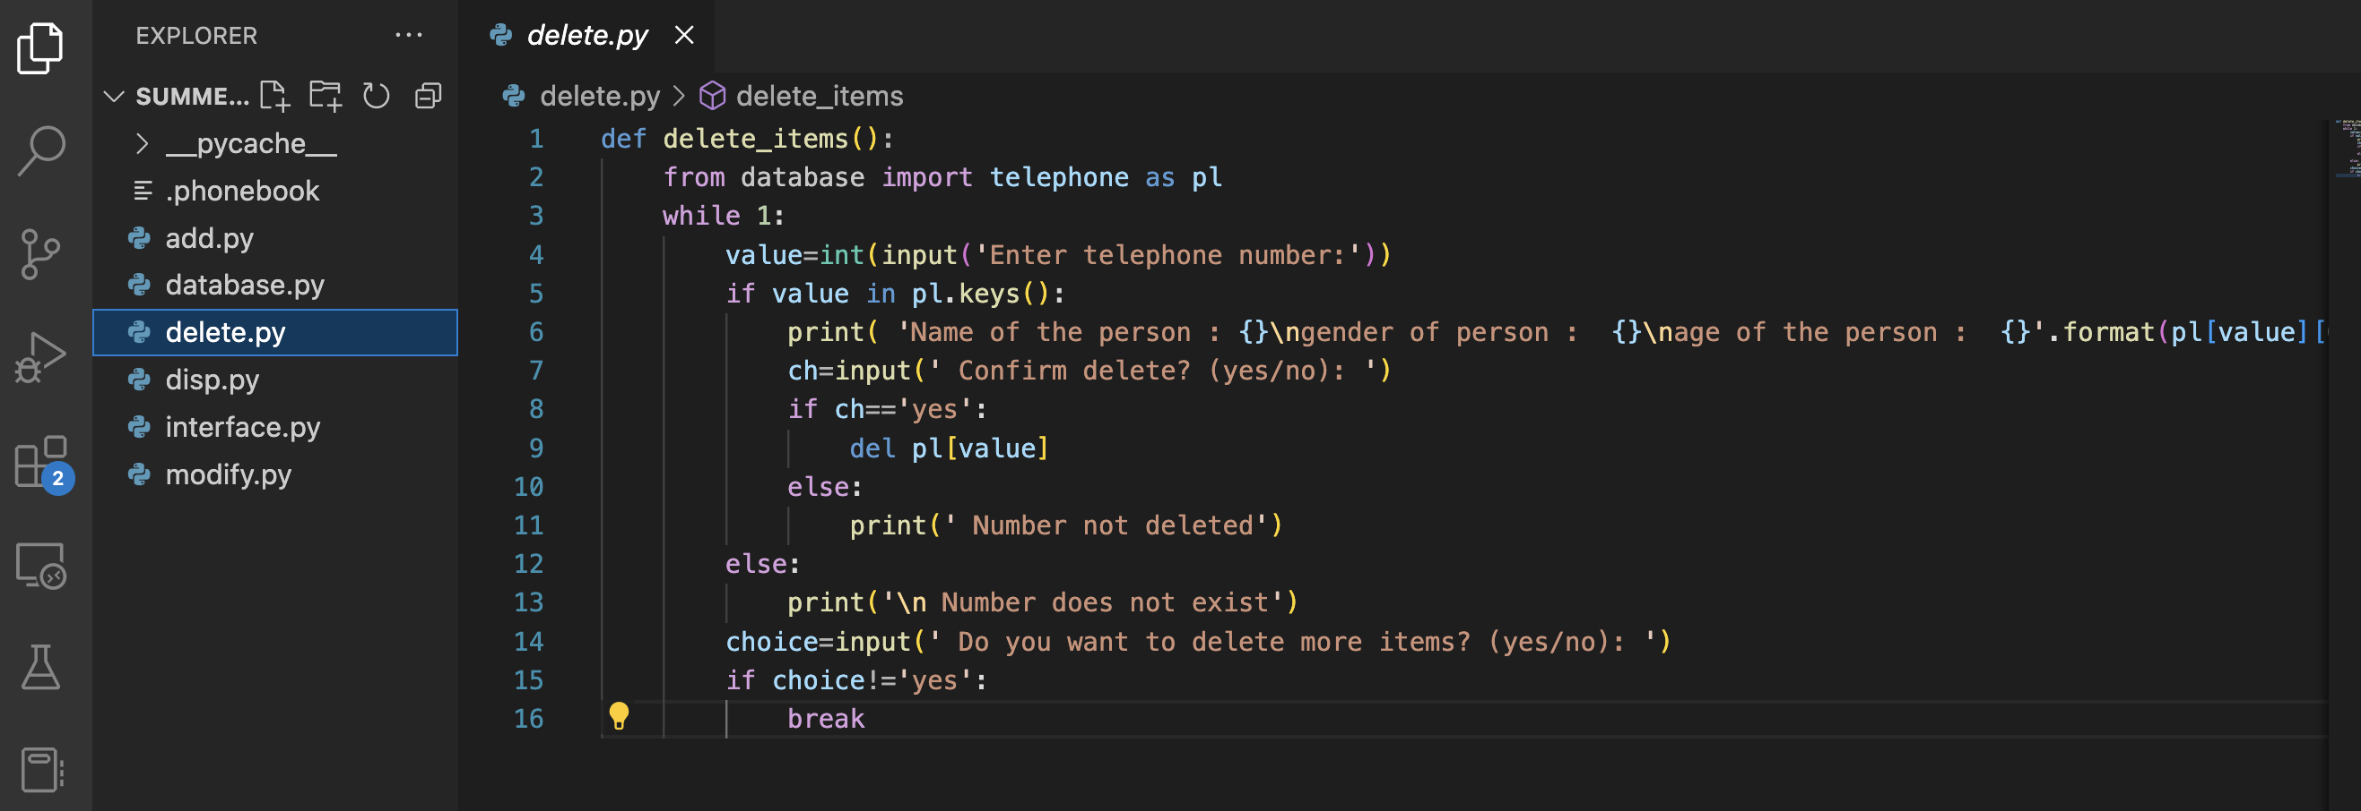
Project Screenshots

Slide 9
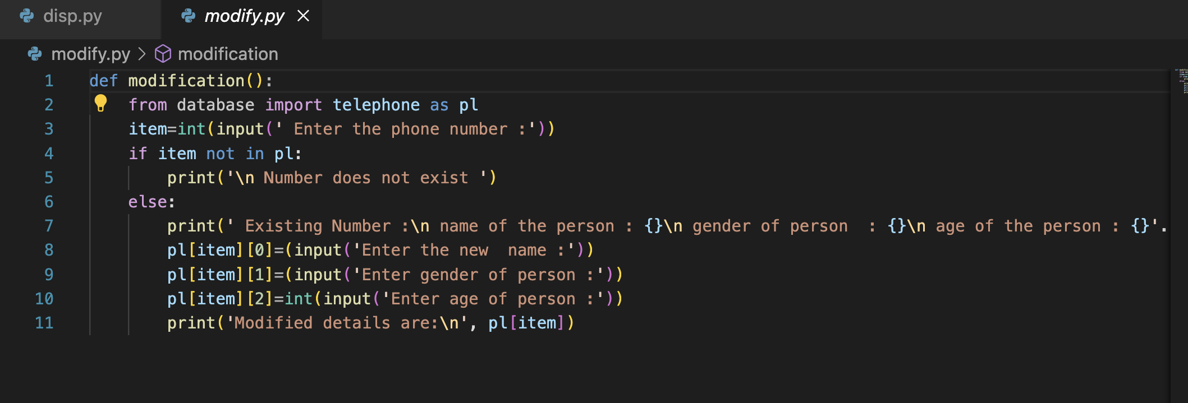
Project Screenshots

Slide 10
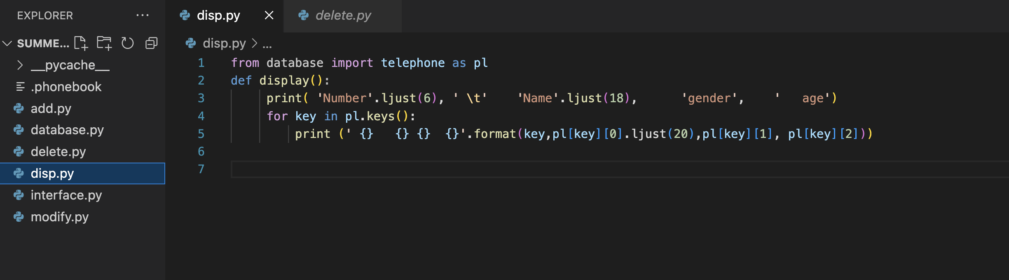
Project Screenshots

Slide 11
Why This Project
The main aim was to implement all the knowledge and skills gained in summer training on a real project.
Practical Implementation
I did this project to get practical exposure of the concepts of DSA.
Learning
I learned a lot from this project and revised all the learnings from my summer training.
Explore
I got the opportunity to explore more about this domain, learn new things and enhance existing skills.
Solve Issues
I learned how to work with Data Structures and Algorithms

Slide 12
Learning Outcome
Skills and technologies learned from the summer training and experience gained from working on real projects.
Implementation of DSA in real life projects
Working with Python

Slide 13

Conclusion
The conclusion we have reached is that the Data structure and algorithm play very important role in any real time projects .

Slide 14
THANK YOU

